Slide 1
2025 ICCAD Contest – Check Point 2
Problem E : RTL Re-connection
Student:
113521142 沈立揚
110501521 徐松廷
110501022 陳冠宏
110501516 蔡昀翰
Advisor:
Andy, Yu-Guang Chen

Slide 2
Outline
Problem Definition
Our Idea- Data Structures
Our Idea- Algorithms
Current Implementation Results (Including Program Demo)
Potential Challenges and Future Works
A Table about Our Project
Screenshot of Successful Registration

Slide 3
Outline
Problem Definition
Our Idea- Data Structures
Our Idea- Algorithms
Current Implementation Results
Potential Challenges and Future Works
A Table about Our Project
Screenshot of Successful Registration

Slide 4
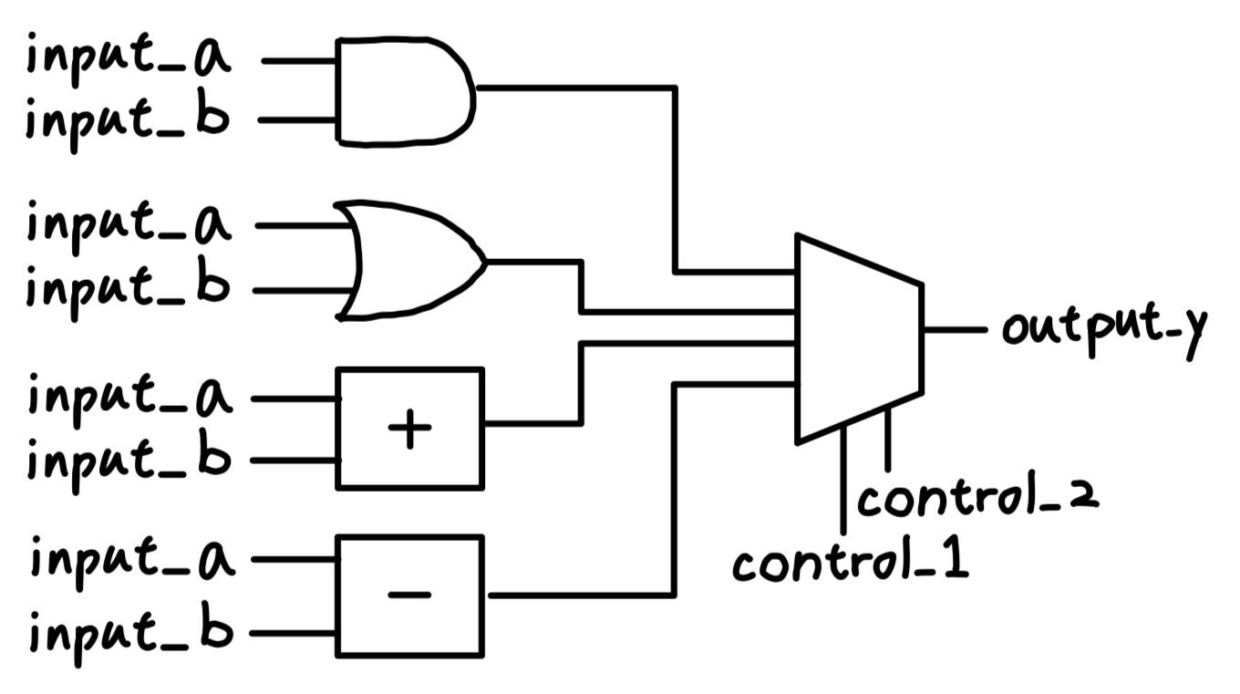
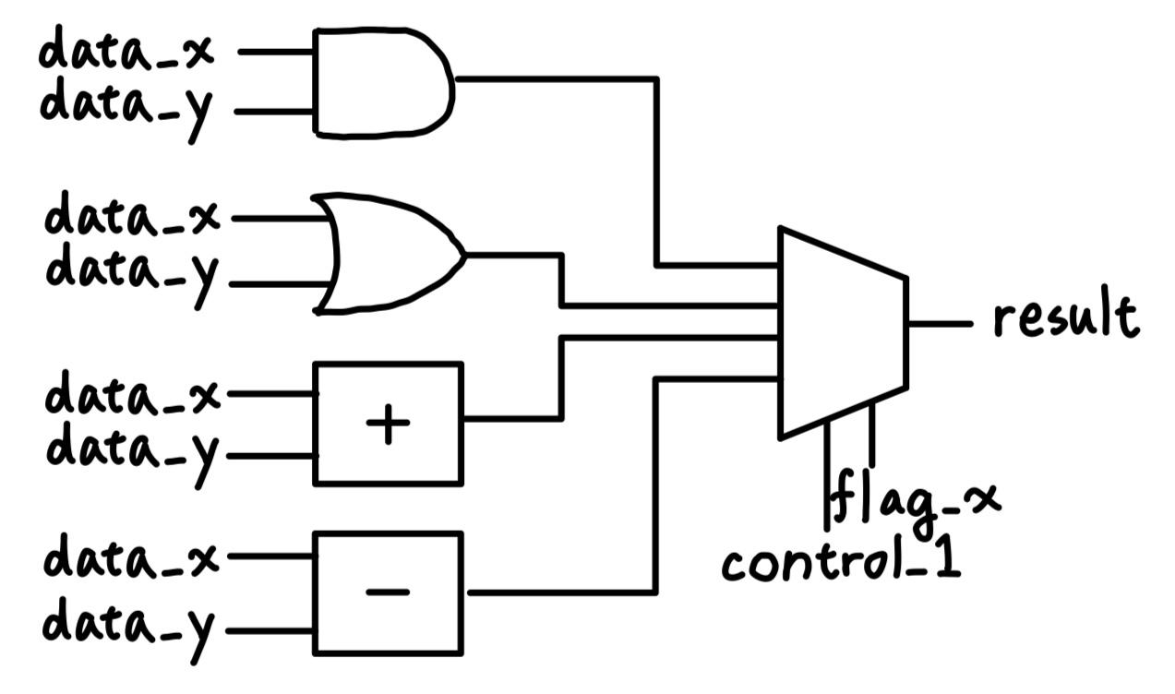
Part 1-Problem Definition
在module更新後I/O訊號名稱會被修改，內部對應的Combinational Logic RTL code 也會被修改。
我們要找到新舊I/O對應的訊號名稱，並確認module更新後邏輯與之前一致

Slide 5
Outline
Problem Definition
Our Idea- Data Structures
Our Idea- Algorithms
Current Implementation Results
Potential Challenges and Future Works
A Table about Our Project
Screenshot of Successful Registration

Slide 6
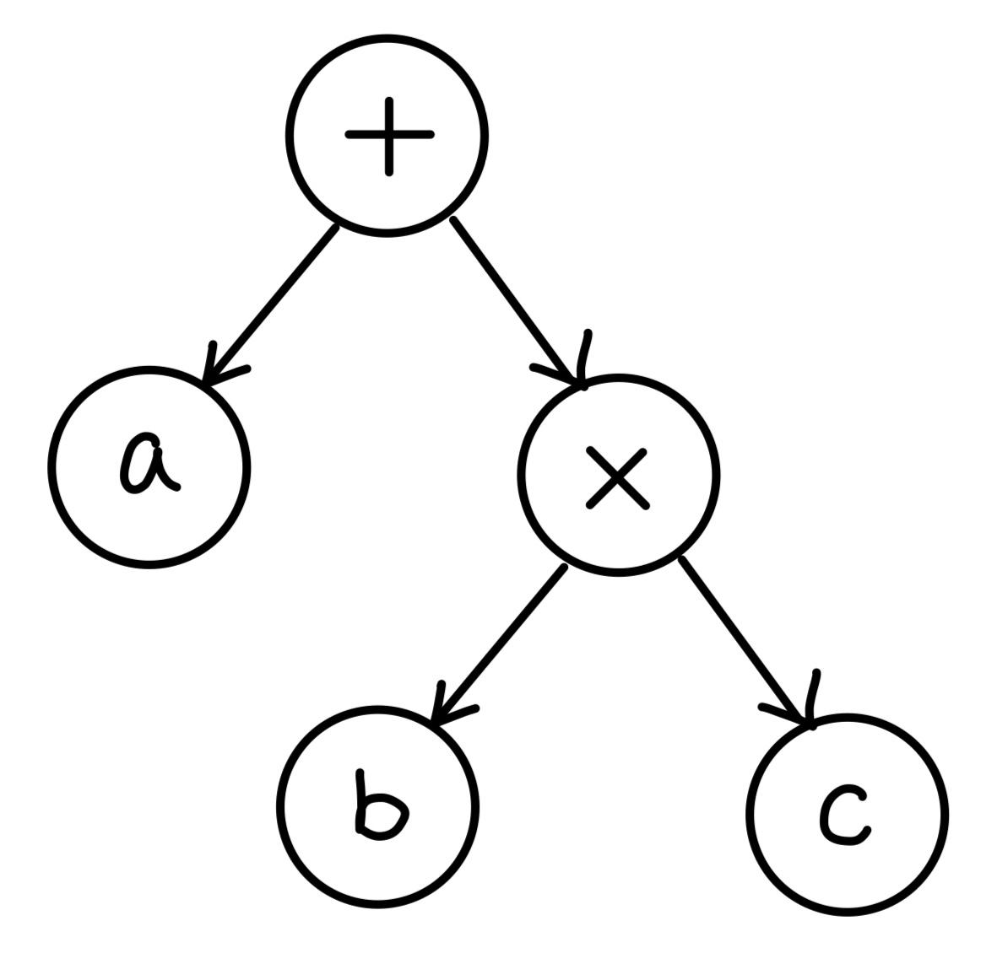
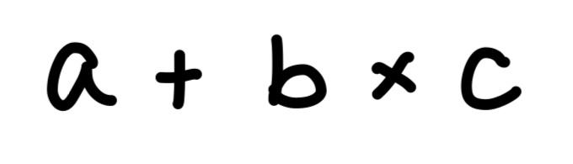
Part 2-Data Structure
我們使用Abstract Syntax Tree(AST)來儲存程式碼
每個node代表一個運算子（+,-,AND,OR,MUX）
node的child則代表該運算子的component
會依照運算優先順序來建立tree

Slide 7
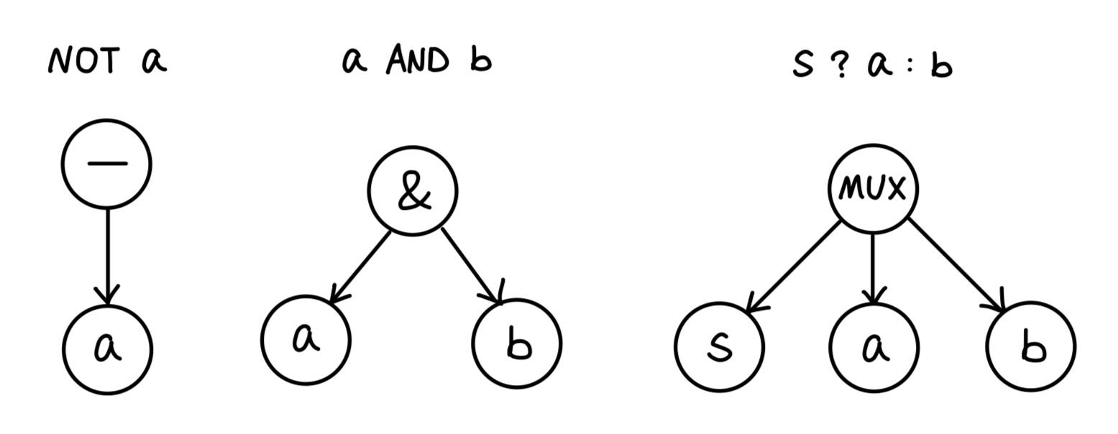
Part 2-Data Structure
AST 的node依照運算子的不同會有不同數量的child

Slide 8
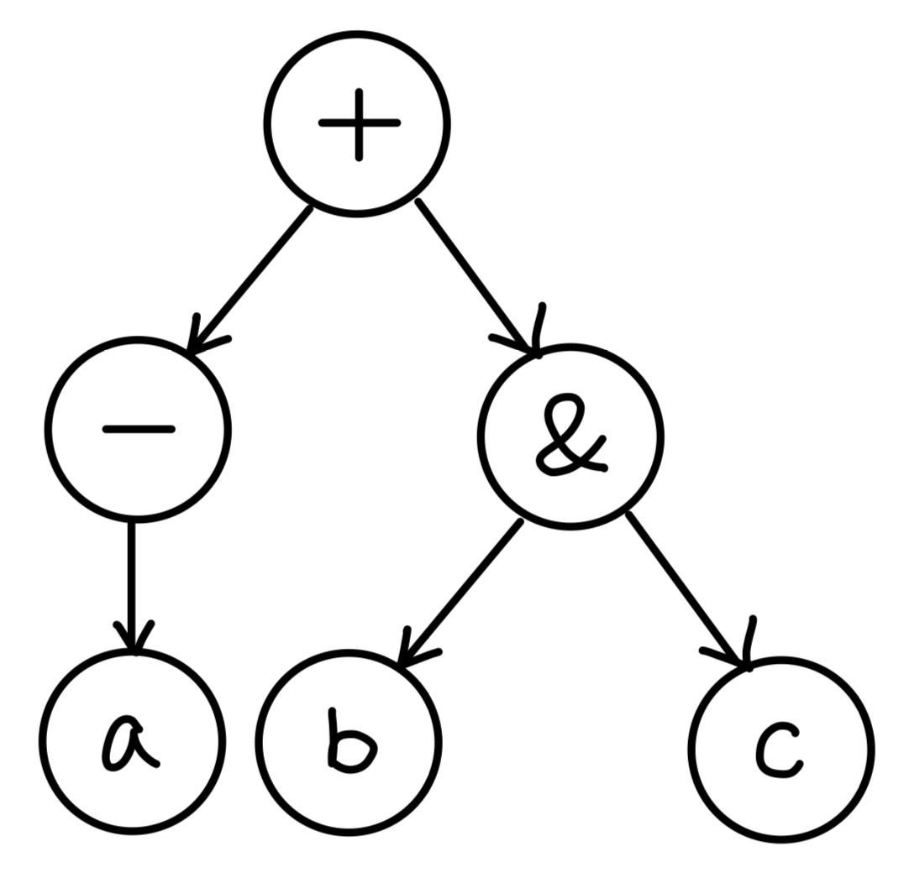
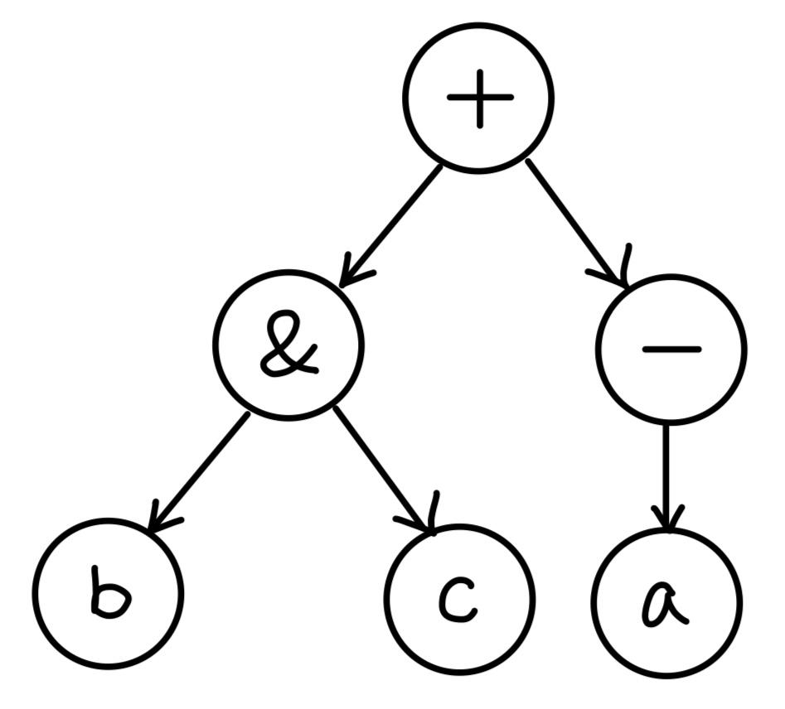
Part 2-Data Structure
AST 的表達並沒有唯一性
用函式normalize 來將AST轉換成唯一表達式
將ASCII code 較大的運算子放在right child來讓運算順序固定

Slide 9
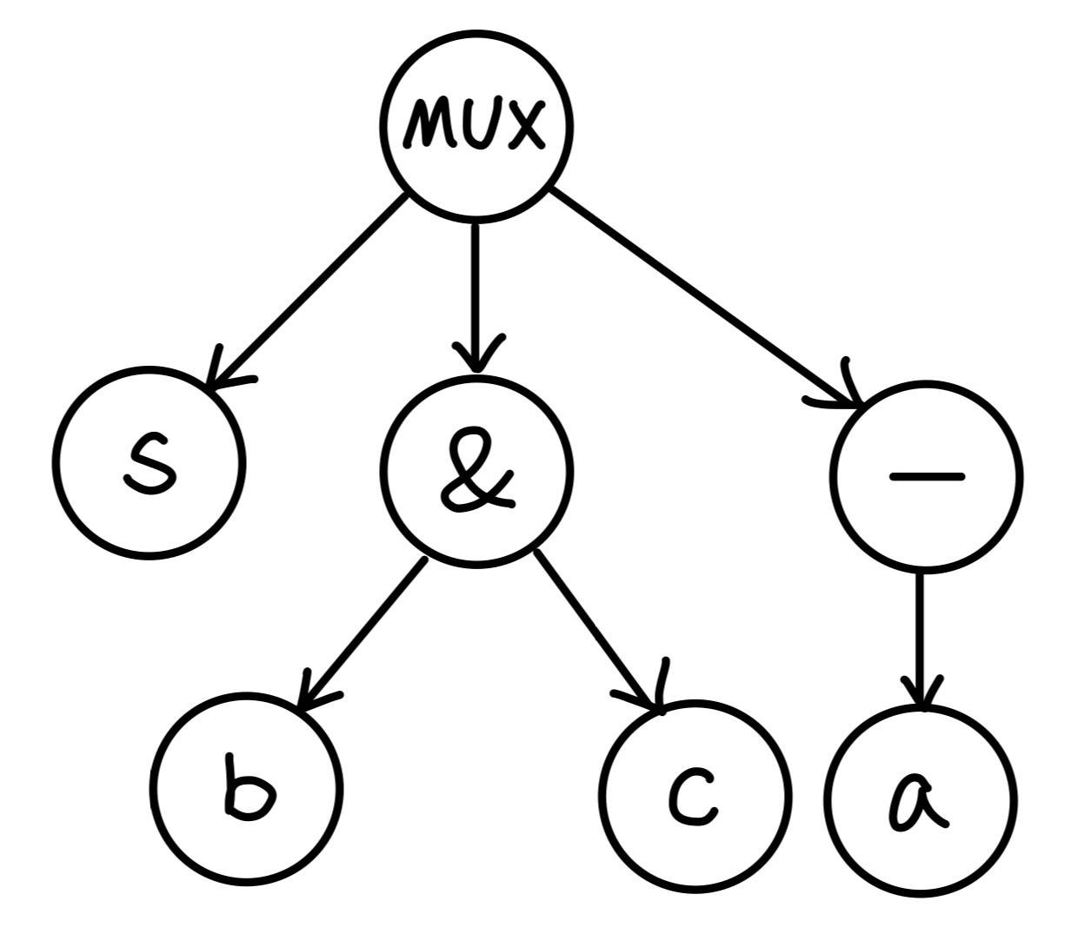
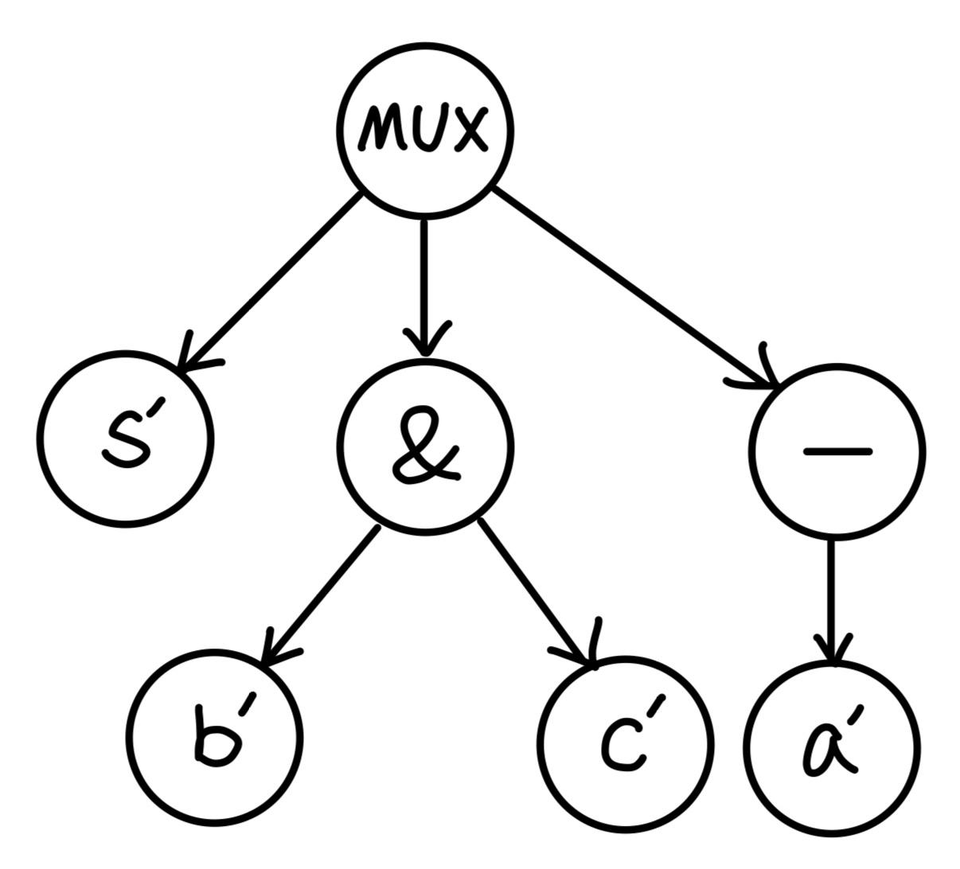
Part 2-Data Structure
得到AST的唯一表達式後就能透過比對tree的結構來找到新舊名稱的對應關係

Slide 10
Outline
Problem Definition
Our Idea- Data Structures
Our Idea- Algorithms
Current Implementation Results
Potential Challenges and Future Works
A Table about Our Project
Screenshot of Successful Registration

Slide 11
Part 3-Algorithm
old AST
create AST
out = in1 + in2
normalize
compare & map
new AST
read input file
&
store data
old ROBDD
create ROBDD
and(out,in1,in2)
normalize
compare & map
new ROBDD

Slide 12
Part 3-Algorithm
兩種module：
logic | operator
and | + | -
or | * | =
not | & | |
nand | ^ | >>
nor | ? :
logic： 結果相同，但logic可能改變
e.g. AB+AC = A(B+C)
⇒ 使用ROBDD
operateor： 有特殊功能
e.g. A>>1, A ? B : C
⇒ 使用AST

Slide 13
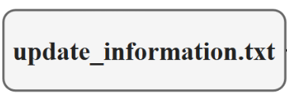
Part 3-Algorithm (AST)
outA
inA
outA
*
inB
old module
outB
+
-
inC
outC
inD
inA
inB
inA
inC
outA | inA, inB, inC
outB | inA, inB
outC | inA, inC
out1 | in1, in2
out2 | in1, in2, in3
out3 | in1, in3
out2
in1
out1
*
in2
new module
out2
+
-
in3
out3
in4
in1
in2
in1
in3

Slide 14
Part 3-Algorithm (AST)
outA
inA
outA
*
inB
old module
outB
+
-
outA⭢out2
inC
outC
inD
inA
inB
inA
inC
outA | inA, inB, inC
outB | inA, inB
outC | inA, inC
out1 | in1, in2
out2 | in1, in2, in3
out3 | in1, in3
out2
in1
out1
*
in2
new module
out2
+
-
in3
out3
in4
in1
in2
in1
in3

Slide 15
Part 3-Algorithm (AST)
outA
inA
outA
*
inB
old module
outB
+
-
inC⭢in3
inC
outC
inD
inA
inB
inA
inC
outA | inA, inB, inC
outB | inA, inB
outC | inA, inC
out1 | in1, in2
out2 | in1, in2, in3
out3 | in1, in3
out2
in1
out1
*
in2
new module
out2
+
-
in3
out3
in4
in1
in2
in1
in3

Slide 16
Part 3-Algorithm (AST)
AST
compare & map
outA
outB
outC
*
-
+
+
-
inB
+
-
-
inA
inB
inA
inC
inA
inB
inA
inA
inC
O(n!)
out1
out2
out3
-
*
+
in2
+
+
-
-
-
in1
in2
in1
in2
in1
in3
in1
in2
in3

Slide 17
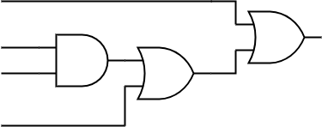
Part 3-Algorithm (ROBDD)
old module
4 inputs ⇒ (4!) 24 orders
e.g. inA < inB < inC < inD,
inA < inC < inB < inD…
⇒ 需要比較 24次
n inputs ⇒ n! orders
⇒ 需要比較 n! 次
inA
inB
outA
inC
inD
new module
Solution:
使用Static variable ordering，越靠近output的變數在順序上會越靠後
⇒ inB < inC < inD < inA;
in2 < in3 < in4 < in1
in1
in2
out1
in3
in4

Slide 18
Outline
Problem Definition
Our Idea- Data Structures
Our Idea- Algorithms
Current Implementation Results (Including Program Demo)
Potential Challenges and Future Works
A Table about Our Project
Screenshot of Successful Registration

Slide 19
Part 4- Current Implementation Results
建構Abstract Syntax Tree (AST)
Simple AST Comparison Algorithm
Unoptimized Program Flow
Simple Test Cases Demo
Notes:
這個部分就是會幫大家簡單介紹一下目前我們實作成果，針對problem E的公開test case我們有實作一些簡單的資料結構和演算法，同時也會為大家簡單的解說實作細節，以及demo我們目前的實作成果，此外我們有根據主辦單位給的測資再生出另外兩組tests，所以目前我們有3組test case

Slide 20
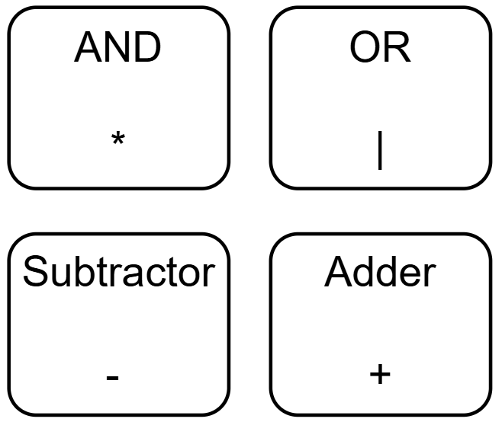

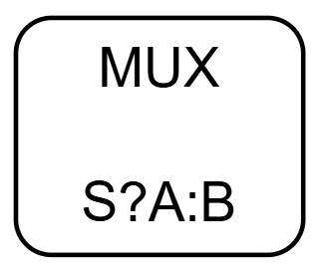
Part 4- Current Implementation Results
建構Abstract Syntax Tree時須特別注意:
1-input operator
2-input operator
3-input operator

Slide 21
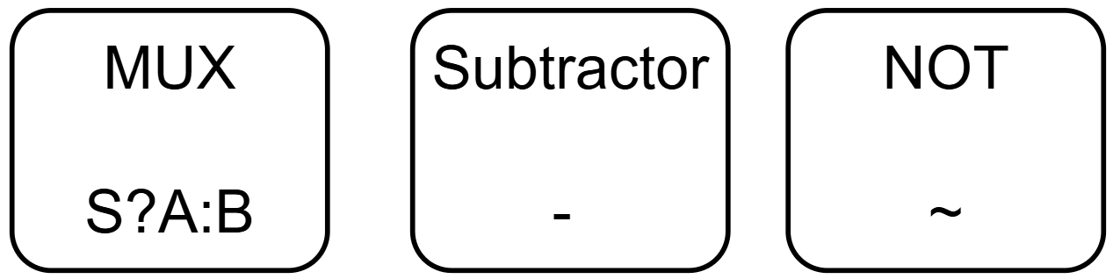
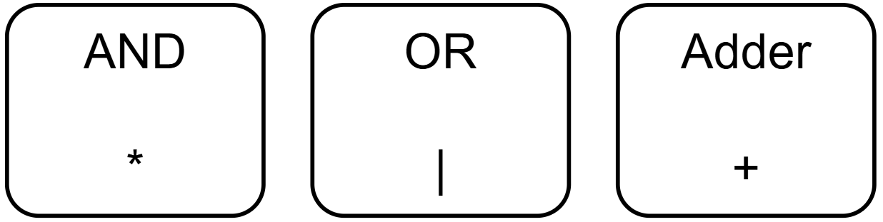
Part 4- Current Implementation Results
AST Comparison Algorithm:比對Abstract Syntax Tree時須特別注意
In-Commutative Operator
Commutative Operator

Slide 22
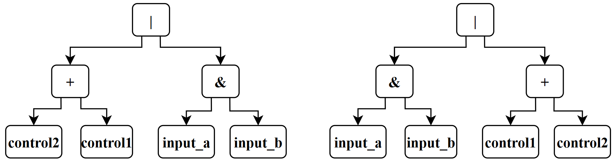
Part 4- Current Implementation Results
AST Comparison Algorithm: 將AST轉換成唯一表達式
賦予commutative operator固定順序 ex: AND(&)> OR (|) > ADD (+)
字串以比大小的方式將較小的string放在left node，較大者在right node

Slide 23
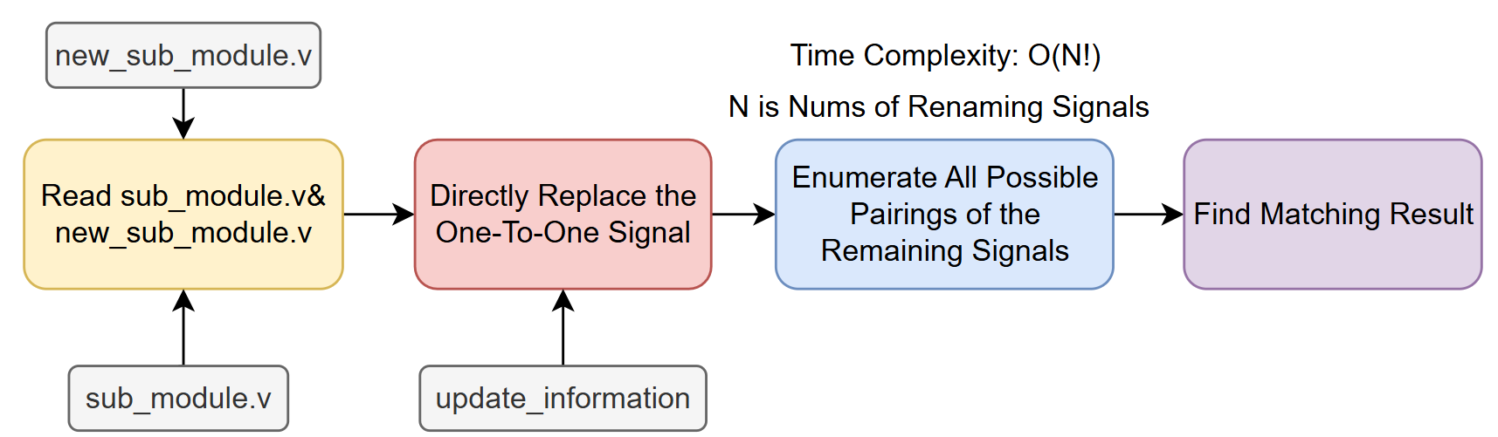
Part 4- Current Implementation Results
Unoptimized Program Flow

Slide 24
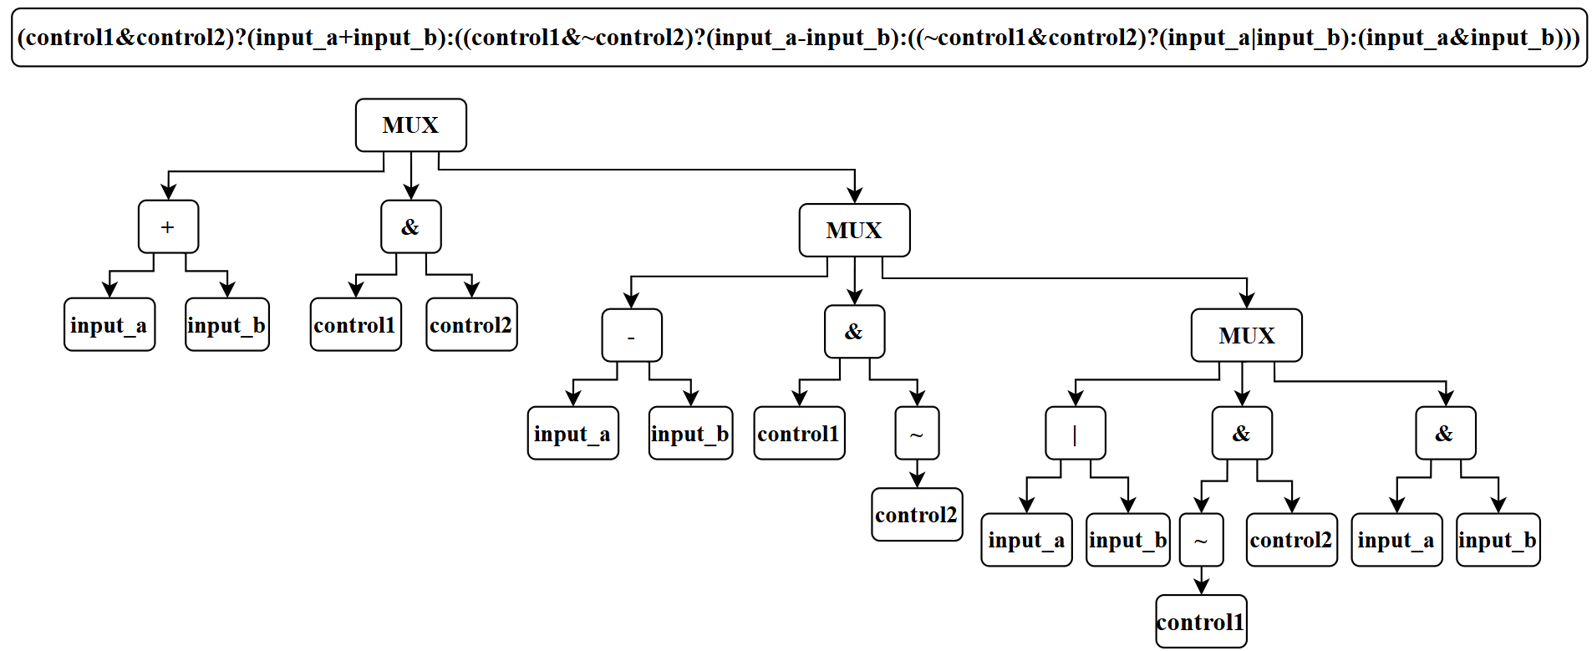
Part 4- Current Implementation Results
Simple Test Cases 1: AST of sub_module

Slide 25
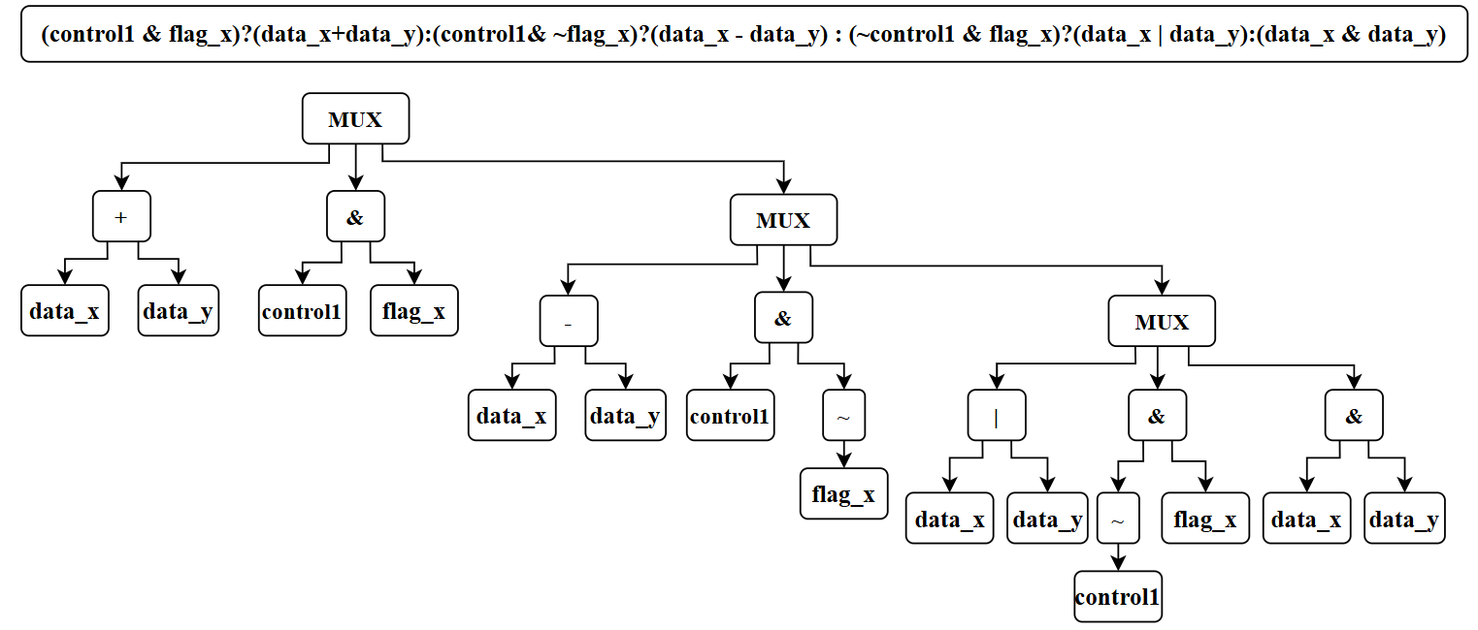
Part 4- Current Implementation Results
Simple Test Cases 1: AST of new_sub_module (固定)

Slide 26
Part 4- Current Implementation Results
Signal Matching Result of Testcase 1:
output_y ->result
control1 -> control1
control2 -> flag_x
input_a -> data_x
input_b -> data_y

Slide 27
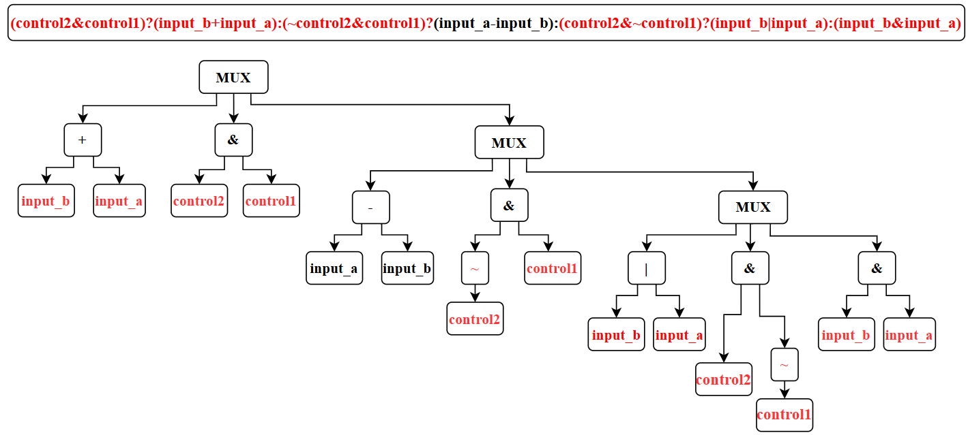
Part 4- Current Implementation Results
Simple Test Cases 2: AST of sub_module

Slide 28
Part 4- Current Implementation Results
Simple Test Cases 2: AST of new_sub_module (固定)

Slide 29
Part 4- Current Implementation Results
Signal Matching Result of Testcase 2:
output_y ->result
control1 -> control1
control2 -> flag_x
input_a -> data_x
input_b -> data_y

Slide 30
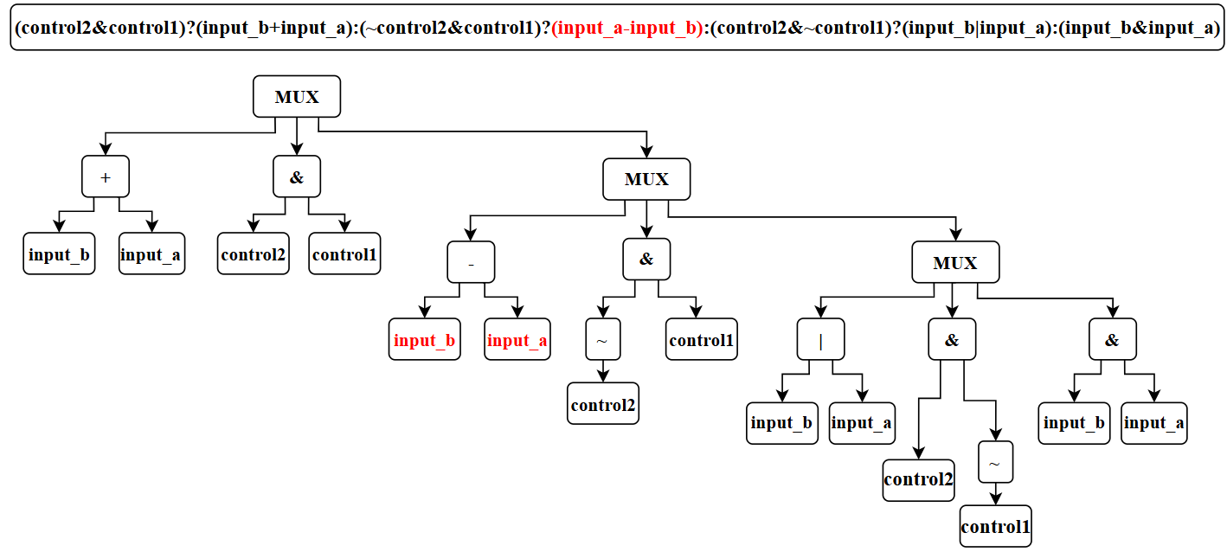
Part 4- Current Implementation Results
Simple Test Cases 3: AST of sub_module

Slide 31
Part 4- Current Implementation Results
Simple Test Cases 3: AST of new_sub_module (固定)

Slide 32
Part 4- Current Implementation Results
Signal Matching Result of Testcase 3:
output_y->result
control1 -> control1
control2 -> flag_x
input_a -> data_y
input_b -> data_x

Slide 33
Outline
Problem Definition
Our Idea- Data Structures
Our Idea- Algorithms
Current Implementation Results
Potential Challenges and Future Works
A Table about Our Project
Screenshot of Successful Registration

Slide 34
Part 5- Potential Challenges and Future Works
Memory Overflow
Abstract tree struct scaled with logic gate increasing. When the circuit is large, this may cause
program memory overflow.
Time Limit Exceeded
Traversal compare two AST to check logic equivalence is impractical with humongous circuit.
False Negative
Some Verilog code may totally be different in AST but result in same logic.
Ex:
assign y = (sel) ? a : b ;
&
assign y = (~sel & b) | (sel & a) ;
These two declaration is logically equivalence but different in AST.

Slide 35
Part 5- Potential Challenges and Future Works
Future Work
- Redundant logic check:
There might be some redundant logic in the circuit, implement the algorithm to search it and
excluding it from AST may improve memory usage and execution time.
- Data Reusing:
When creating a new node on tree, check if there is a node with same input, if there is,
Reusing the data can improve memory usage.
- And-Inverter-Graph:
The AIG data structure can support strict semantic representation, not like AST which may
eliminate the false negative problem.
Transfer some high-level syntax in AST like (?:, >>, <<) into base logic and build an AIG.

Slide 36
Outline
Problem Definition
Our Idea- Data Structures
Our Idea- Algorithms
Current Implementation Results
Potential Challenges and Future Works
A Table about Our Project
Screenshot of Successful Registration

Slide 37
Part 6- A project table
Team ID | Problem Title | Team Member | Project Overview | Platform Used
cade0002 | RTL Re-connection | 徐松廷 陳冠宏 蔡昀翰 沈立揚 | 在RTL設計中，子模組升級或訊號名稱變更時，Top模組需同步更新接線，並解決名稱對應、訊號匹配及功能一致性等問題。 | Linux作業系統 g++編譯器

Slide 38
Part 6- A project table
Applied Technologies and Knowledge | Implementation Details
Abstract Syntax Tree (AST) Reduced Ordered Binary Decision Diagram (ROBDD) | 純邏輯moudle採用ROBDD進行比對，並透過Static Variable Ordering提升比對效率；運算moudle則使用AST進行比對。

Slide 39
Outline
Problem Definition
Our Idea- Data Structures
Our Idea- Algorithms
Current Implementation Results
Potential Challenges and Future Works
A Table about Our Project
Screenshot of Successful Registration

Slide 40
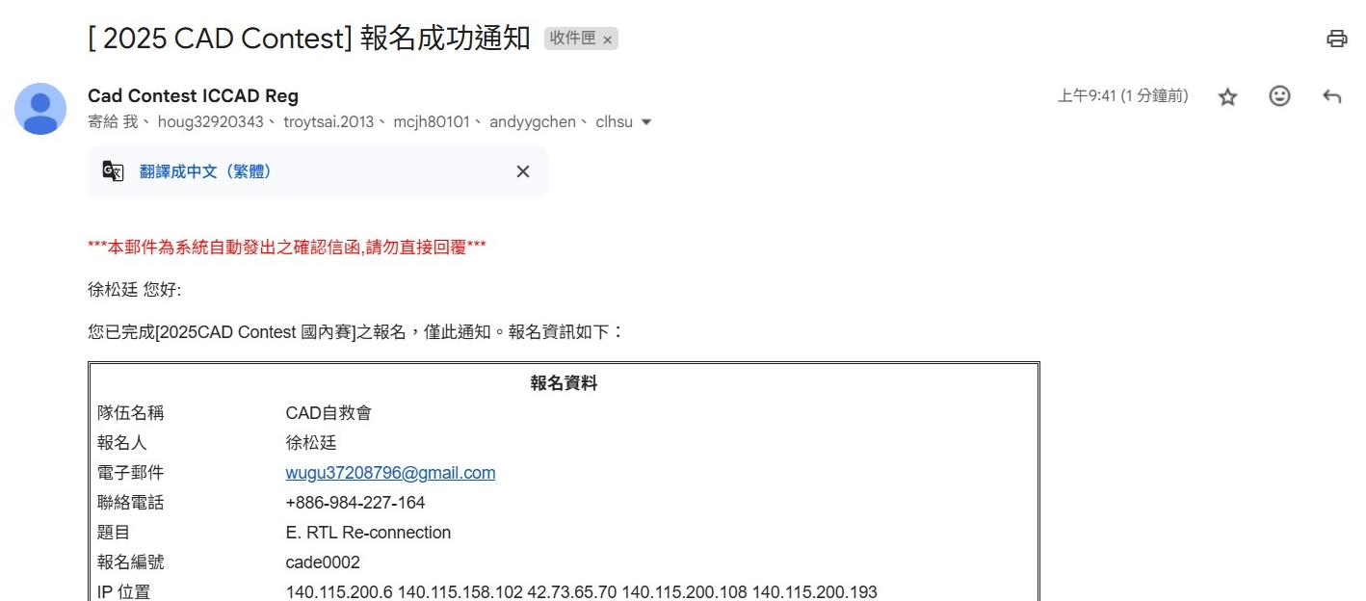
Part 7-Successful Registration Screenshots

Slide 41
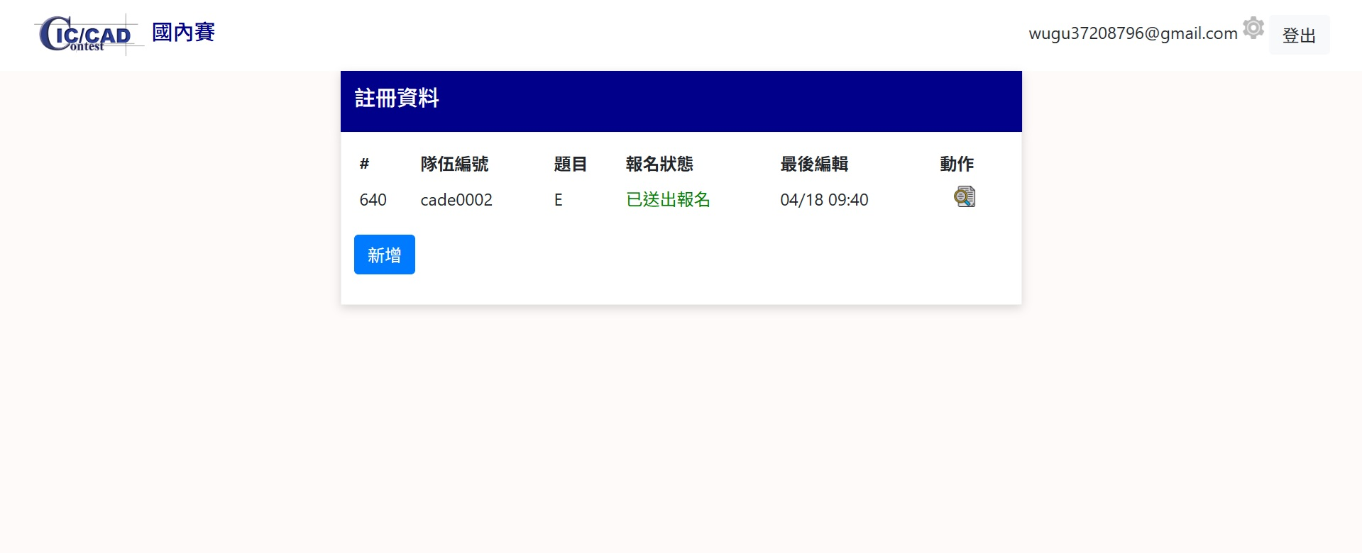
Part 7-Successful Registration Screenshots

Slide 42
Thanks for watching.

